Slide 1
SWASTIK PROVISION STORE

Slide 2
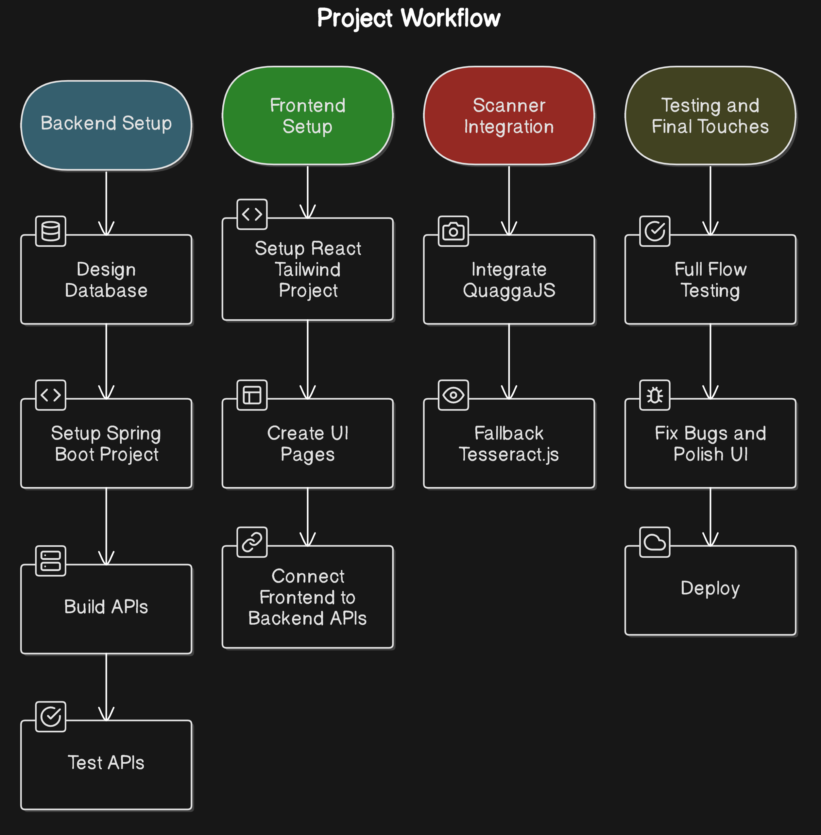
PROJECT WORKFLOW

